Slide 1
Assessing blood samples for malaria. Oral Interview
By Olumide Fadahunsi

Slide 2
Project review points
Malaria is a life-threatening disease killing around 600,000 people every year
Parasite identification done by experts and is susceptible to human error, this app aims to remove any human error
Analyse Red Blood Cells (RBC) in thick and thin blood smears
90% of malaria deaths are in the African region, and there is wide spread smartphone usage in the continent, with 83.6% of the smartphone using the android platform
2 apps currently that have achieved this, 1 is publicly available for download
Notes:
Caused by parasites, 5 parasites cause malaria
Thick is for identifying malaria, thin is for identifying species
Malaria is listed by the World Health Organisation (WHO) as a life-threatening disease
5 Plasmodium Parasites cause malaria, P. falciparum, P. vivax, P. ovale, and P. malariae, P. Knowles
Parasite identification is mainly done by a medical expert examining typically giemsa stain blood smears under a microscope
A lot of work done to use computer Vision in the medical field – AlexNet
Specific to malaria – Work to identifiy P. Vivax and P.Falciparum , Detect Malaria with an accuracy of 93.4%
African region is disproportionately dealing with malaria , 90% of the deaths in Africa
Africa also skipped the landline infrastructure and now the mobile phone is of massively important to the continent
There are to my knowledge 2 Mobile apps , both on android that do exactly what I plan to do, 1 is not publicly available, another is

Slide 3
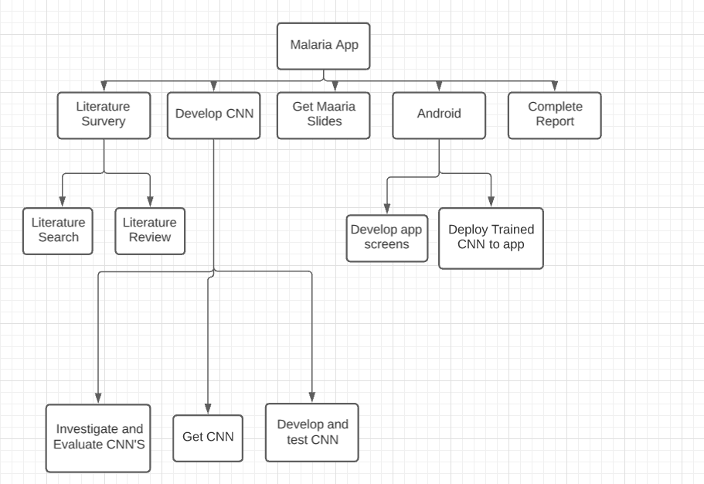
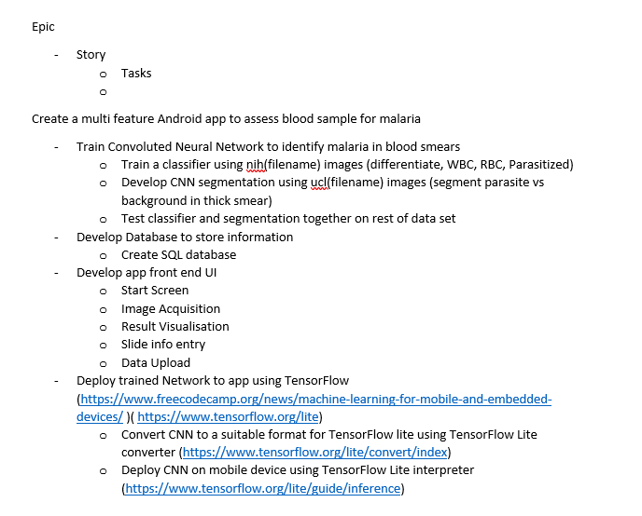
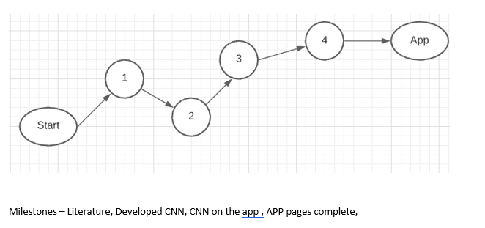
Original action plan
Activity | Estimate Duration
Literature Search | 4 weeks
Literature review | 2 weeks
Investigate and evaluate CNN’s | 1 weeks
Get CNN’s | 2 days
Develop and test CNN’s | 8 weeks
Get malaria Slides | 2 days
Develop App screens | 4 weeks
Deploy trained CNN to app | 2 weeks
Complete Report | 3 weeks
Total Effort | 26 weeks (approx. 7 months)

Slide 4
Issues
Zero previous knowledge of CNN’s or app development
Had a abstract view of how CNN’s work, practical application took much longer than expected.
PyCharm issues, multiple ways to load data
Testing the multiple pre- trained networks, and understanding them took a long time, even when given.
Data augmentation to make sure I was efficiently training the classifier
Coding the app has been relatively straightforward, Android documentation has made is much easier and previous knowledge of java helped
Notes:
Understanding the given network.
Given a network by Adrian Clark. Was loading the data a couple is array or data generator
PyCharm issues – Understanding the IDE
- Extension issues – Python installation
- Ongoing issues with rescaling the images to
- Eventually move to using google collab , much simpler use
- Import statements, tensorflow_keras . Tensorflow.keras can’t be interchanged
Depending on the network the images need to be rescaled into a specific height and width, they also need to be imported in a specific way
By augmenting the data, you change the images in a way to mimic real world probabilities so the classifier can work in less than ideal conditions.

Slide 5
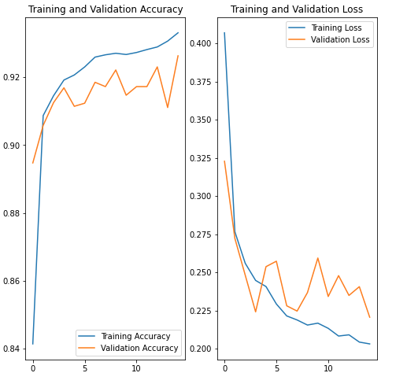
MVP – Deliverables
MVP Expected –
App, that has the CNN on it and can analyse images
Current deliverables
Working classifier, at 92% validation accuracy
The app has a working database, that save slides information
The app can access the camera, and gallery to load images
Features wanted
Full CNN on the app working (Parasite identification – stretch goal)
Share function
Link database with image metadata
Export Database

Slide 6
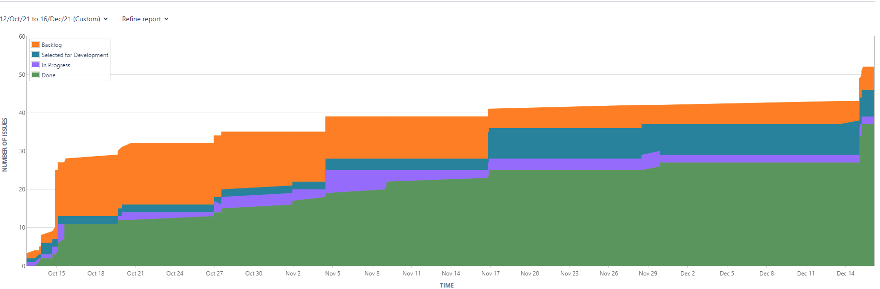
Jira / Gitlab

Slide 7
Updated time estimates
Activity | Estimate Duration
Literature Search | 4 weeks - Done
Literature review | 2 weeks - Done
Investigate and evaluate CNN’s | 1 weeks - Done
Get CNN’s | 2 days – Done
Develop and test CNN’s | 8 weeks – Done
Get malaria Slides | 2 days - Done
Develop App screens | 4 weeks – 30% Done
Deploy trained CNN to app | 2 weeks
Complete Report | 3 weeks
Total Effort | 26 weeks (approx. 7 months)
Activity | Estimate Duration
Develop app screens | 5 weeks
Deploy trained CNN to app | 3 weeks
Complete CNN with classifier and segmentation | 5 weeks
Complete Report | 4 Weeks
Total Effort | approx 17 weeks

